Slide 1
Introduction to the Olympiad Problem
This problem was part of the U.S.S.R. 1982 Math Olympiad for 10th graders.
4 of 53 students who participated in the Olympiad correctly solved this problem.
One of those four students, Grigori Perelman, later on, in 2006, proved one of the Millenium Prize Problems - Poincare Conjecture.

Slide 2
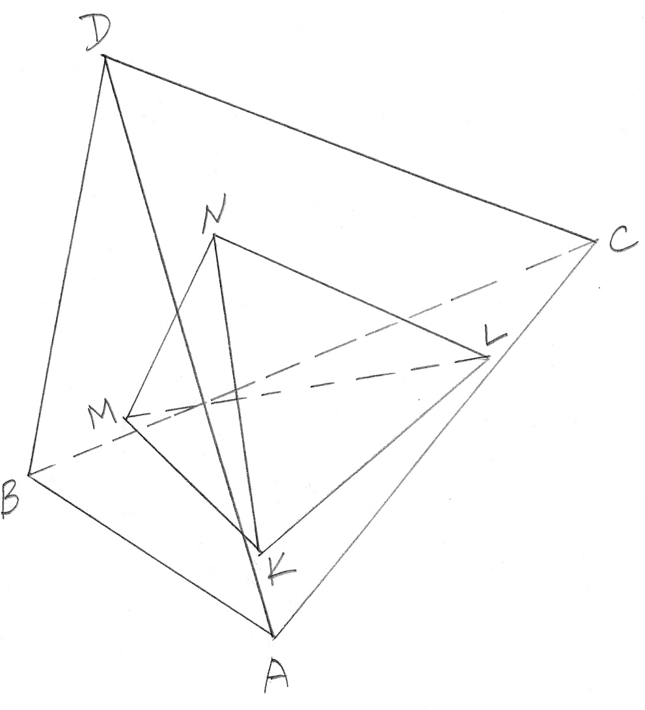
Introduction
If one tetrahedron is placed inside another tetrahedron, can its ‘perimeter’ (the sum of the lengths of all edges) be greater than the ‘perimeter’ of the outer tetrahedron?

Slide 3
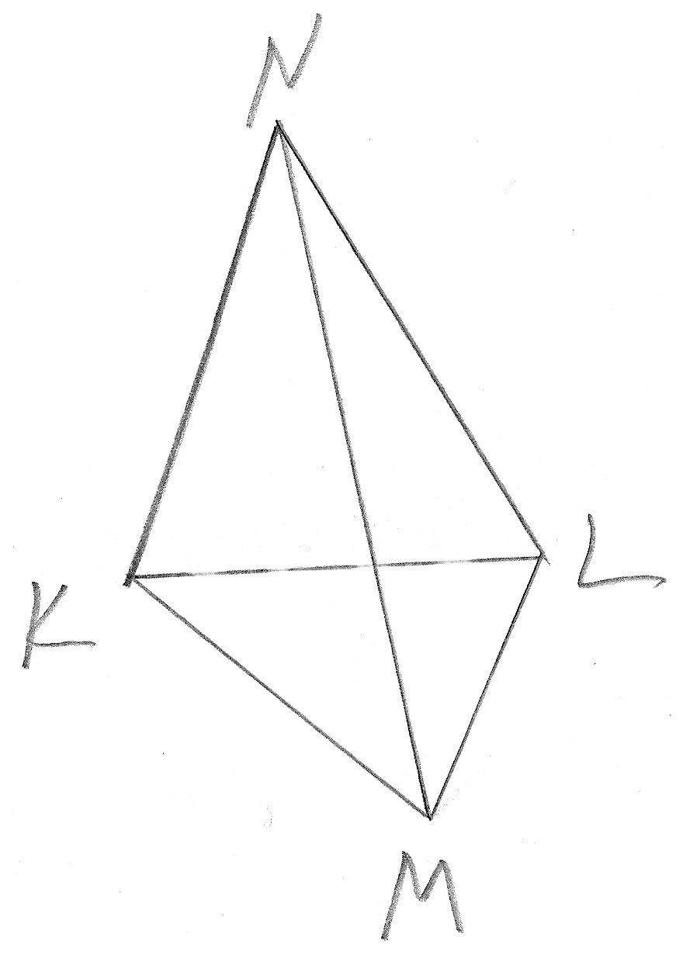
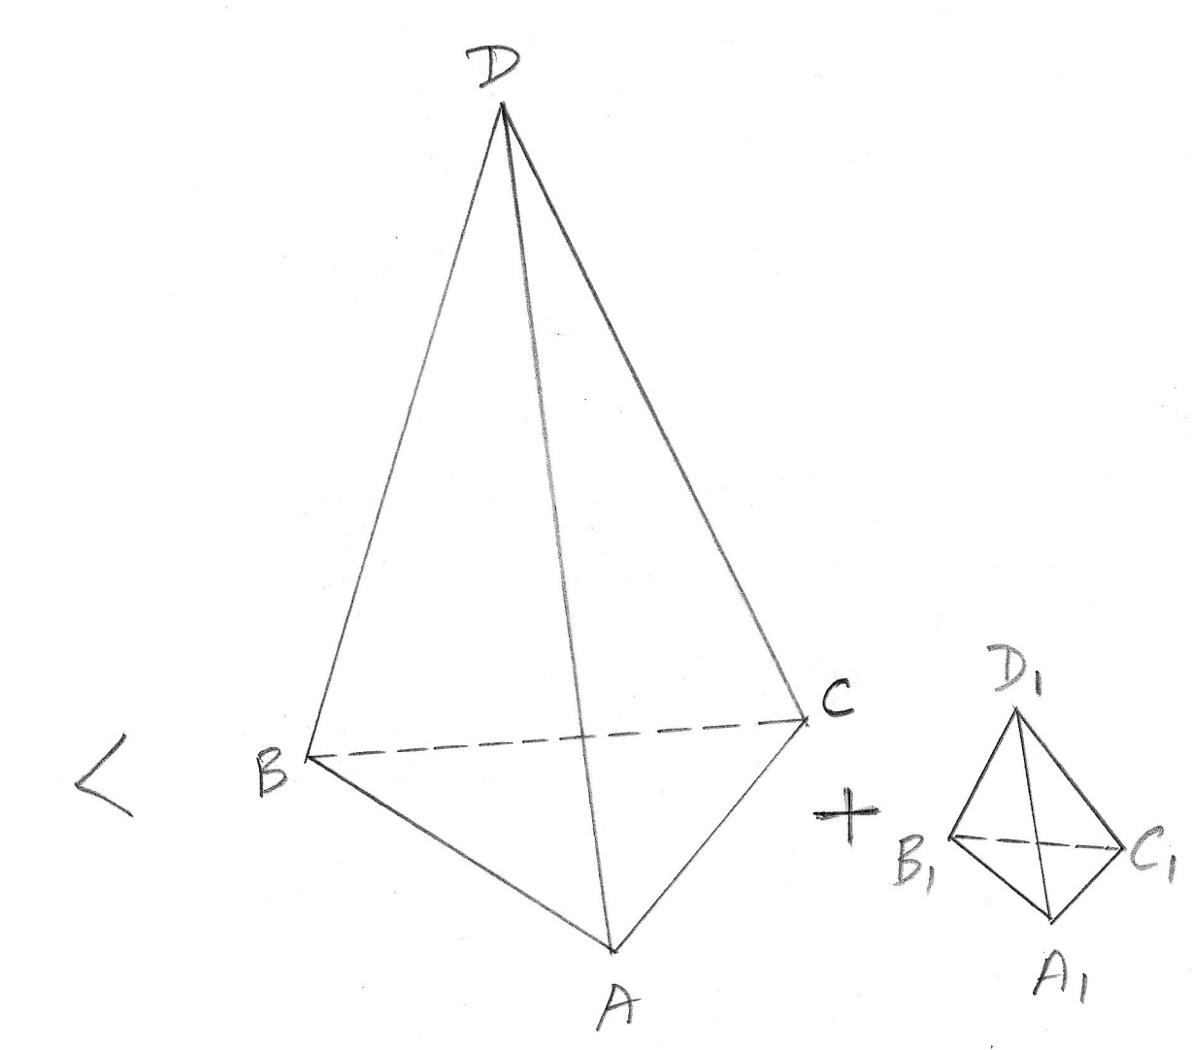
Introduction
For any pair of nested tetrahedra:
P(KLMN) < (4/3)*P(ABCD).

Slide 4
Introduction
The value of P(KLMN) can be infinitely close to
4/3 *P(ABCD), so that coefficient 4/3 cannot be reduced in the inequality
P(KLMN) < (4/3)*P(ABCD).

Slide 5
Introduction
The winners of the Olympiad who correctly solved this problem provided three different methods of proof.

Slide 6
Introduction
Method #1 is based on elementary geometry and algebra.

Slide 7
Introduction
Method #2 uses Vector Analysis that deals with the projections of 3-D vectors onto any straight line.

Slide 8
Introduction
Method #3 is related to the principle of Linear Programming: the maximum of the objective function is reached in the vertices of linear inequality constraints.

Slide 9
Introduction
Studying these three different methods of proof for the same inequality is both instructive and inspiring.

Slide 10
The XVI Math Olympiad of the U.S.S.R. , 1982
Tetrahedron KLMN is placed inside tetrahedron ABCD. Let P(LKMN) be the sum of lengths of all edges of tetrahedron KLMN. Also, P(ABCD) denotes the same property of tetrahedron ABCD. Assume that 4 vertices of the outer tetrahedron ABCD do not belong to one plane.
Prove that P(KLMN) < (4/3)*P(ABCD).

Slide 11
Proof #1
The value of P(KLMN) can be almost equal to
(4/3)*P(ABCD)

Slide 12
Proof #1
AD = BD = CD = a
AB = AC = CB ≈ 0
P(ABCD) ≈ 3a
KM ≈ KN ≈ LM ≈ LN ≈ a
KL ≈ MN ≈ 0
P(KLMN) ≈ 4a
P(KLMN) ≈ (4/3)*P(ABCD)

Slide 13
Proof #1
The chain of inequalities
P(KLMN) ≤ X ≤ Y <…≤ Z < (4/3)*P(ABCD).

Slide 14
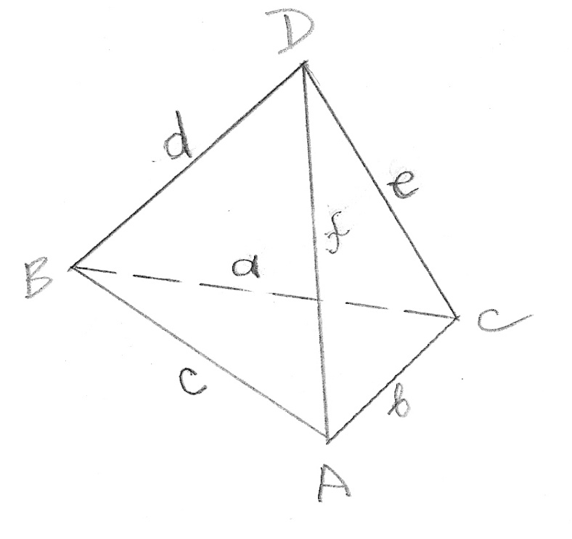
Proof #1
Let ∆ABC be the face of ABCD with the largest perimeter. Then, P(ABCD) ≤ 2*P(ABC).

Slide 15
Proof #1
a + d + e ≤ a + b + c
b + f + e ≤ a + b + c
c + d + f ≤ a + b + c
(a + b + c) + 2(d + e + f) ≤ 3(a + b + c)
2(d + e + f) ≤ 2(a + b + c)
d + e + f ≤ a + b + c
a + b + c + d + e + f ≤ 2(a + b + c)

Slide 16
Proof #1
P(KLMN) ≤ 2*P(KLM)
where P(KLM) is the perimeter of ∆KLM that is a face of tetrahedron KLMN with the largest perimeter.

Slide 17
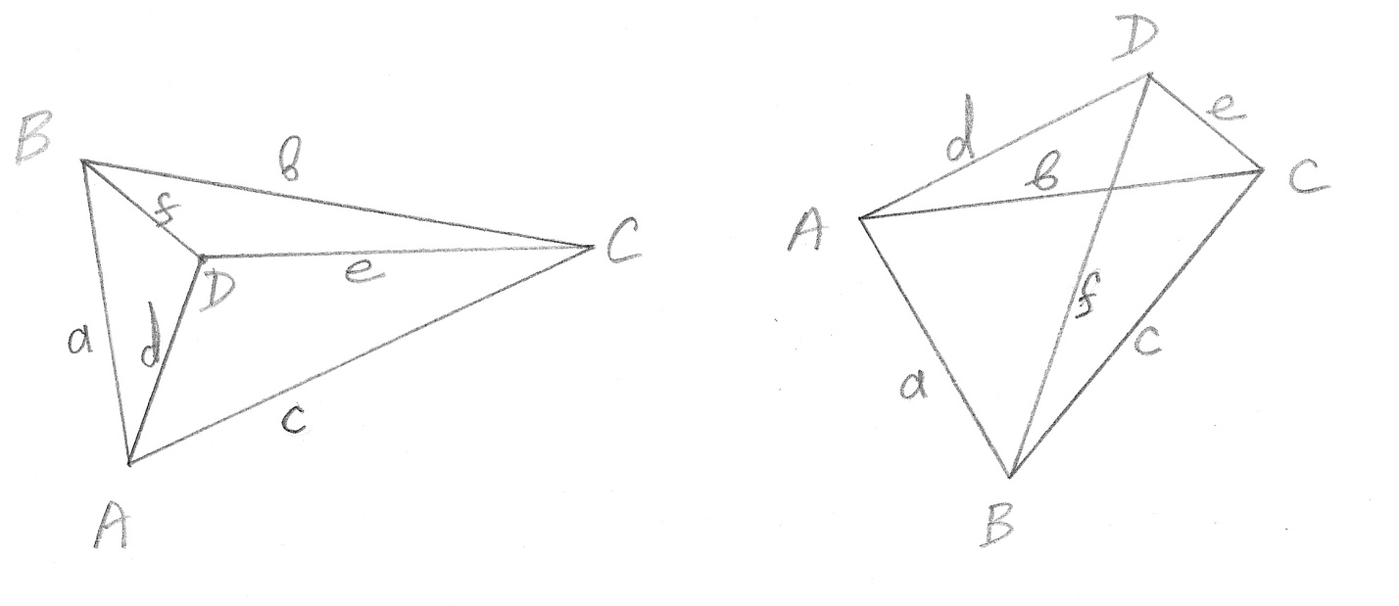
Proof #1
P(KLM) ≤ PB(ABCD)
where PB(ABCD) is the perimeter of the boundary formed by the projection of tetrahedron ABCD onto the plane of KLM:

Slide 18
Proof #1

Slide 19
Proof #1

Slide 20
Proof #1

Slide 21
Proof #1

Slide 22
Proof #1
PB(ABCD) < (2/3)*P(A1, B1, C1, D1)
where A1, B1, C1, D1 are the projections of 4 vertices A, B, C, D of tetrahedron ABCD on the plane of KLM.
P(A1, B1, C1, D1) = a + b + c + d + e + f
where a, b, c, d, e, f are the lengths of straight line segments between the projection points A1, B1, C1, D1.

Slide 23
Proof #1

Slide 24
Proof #1
The Triangle Inequality Theorem
a ≤ f + d
b ≤ f + e
c ≤ d + e
a + b + c ≤ 2(e + f + e)
3(a + b + c) ≤ 2(e + f + e + a + b + c)
a + b + c ≤ (2/3)*(e + f + e + a + b + c)

Slide 25
Proof #1

Slide 26
Proof #1
The Triangle Inequality Theorem
a + c ≤ b
d + e ≤ b
a + d ≤ f
c + e ≤ f
2(a + c + d + e) ≤ 2(b + f)
a + c + d + e ≤ 2(b + f)

Slide 27
Proof #1
3(a + c + d + e) ≤ 2(a + c + d + e + b + f)
a + c + d + e ≤ (2/3)*(a + c + d + e + b + f)

Slide 28
Proof #1
Note: In both cases, any triangle inequality can become equality only if all three sides of the triangle form a straight line.
Since tetrahedron ABCD has 4 vertices that do not belong to one plane,
PB(ABCD) < (2/3)*P(A1, B1, C1, D1).

Slide 29
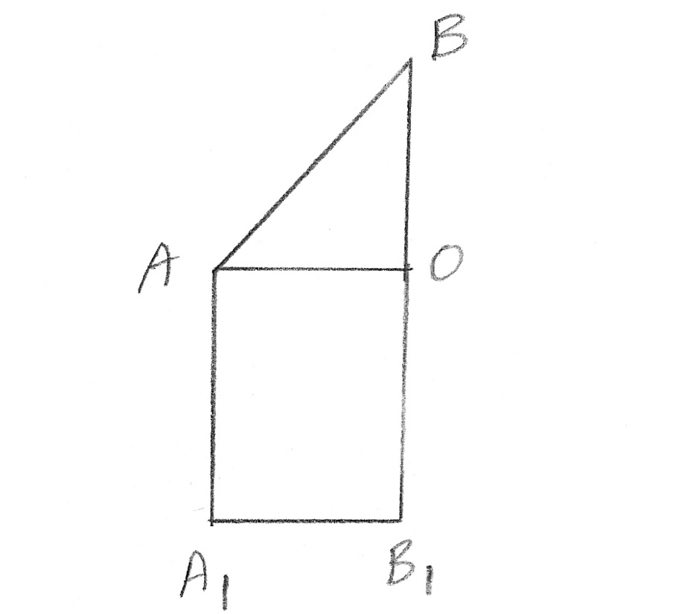
Proof #1
P(A1, B1, C1, D1) < P(ABCD)

Slide 30
Proof #1
Note: If an edge of tetrahedron ABCD is parallel to the plane of KLM, its length is equal to the length of its projection.
Since tetrahedron ABCD has four vertices that do not belong to one plane, only one face with its 3 edges can be parallel to the plane of KLM.
Hence, P(A1, B1, C1, D1) < P(ABCD).

Slide 31
Proof #1
P(KLMN) ≤ 2P(KLM) ≤ 2PB(ABCD) <
< 2*(2/3)*P(A1,B1,C1,D1) < (4/3)*P(ABCD)
P(KLMN) < (4/3)*P(ABCD)

Slide 32
Proof #2
Postulate: An inequality such as
P(KLMN) < (4/3)*P(ABCD)
is true if and only if the same inequality is true for the projections of both sets of vectors onto ANY straight line in the 3-D space.
In general, it is true for any inequality between the sums of lengths of two sets of vectors in the 3-D space.

Slide 33
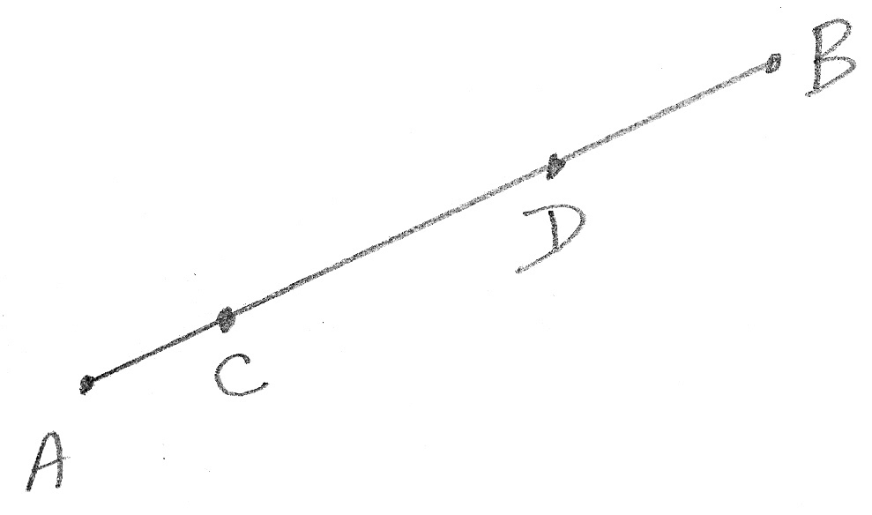
Proof #2
Points A, B, C, and D are the projections of four vertices of a tetrahedron onto straight line AB.

Slide 34
Proof #2
Let ∆ denote the length of the straight line segment that contains all four points.
3∆ ≤ AB + AC + AD + CD + DB + BC ≤ 4∆.
Assume that 4 points are arranged on the straight line in this order: A –> C –> D –> B.

Slide 35
Proof #2
AB = AC + CD + CB
AB ≤ AD + BC
(If points C and D are co-located, then:
AB = AD + BC)
2AB ≤ AC + CD + CB + AD + BC
3AB ≤ AB + AC + CD + CB + AD + BC
3∆ ≤ AB + AC + AD + CD + DB + BC

Slide 36
Proof #2
AB = AB
AC + CD + DB = AB
AD ≤ AB
BC ≤ AB
(If points A and C are co-located, and points D and B are co-located, then:
AB = AD and AB = BC)

Slide 37
Proof #2
AB + AC + CD + DB + AD + BC ≤ 4AB
AB + AC + CD + DB + AD + BC ≤ 4∆

Slide 38
Proof #2
Let ∆1 and ∆2 denote the lengths of projections of tetrahedra KLMN and ABCD respectively onto a straight line.
∆1 ≤ ∆2
3*∆1 ≤ 3*∆2 ≤ AB + AC + AD + CD + DB + BC
3*∆1 ≤ P(ABCD)
(3/4)*4*∆1 ≤ P(ABCD)

Slide 39
Proof #2
P(KLMN) ≤ 4*∆1
(3/4)*P(KLMN) ≤ P(ABCD)
P(KLMN) ≤ (4/3)*P(ABCD)

Slide 40
Proof #2
Equality P(KLMN) = (4/3)*P(ABCD)
is achieved only if all the following conditions are true:
∆1 = ∆2 = ∆,
points C and D are co-located,
points K and L are co-located,
points M and N are co-located.

Slide 41
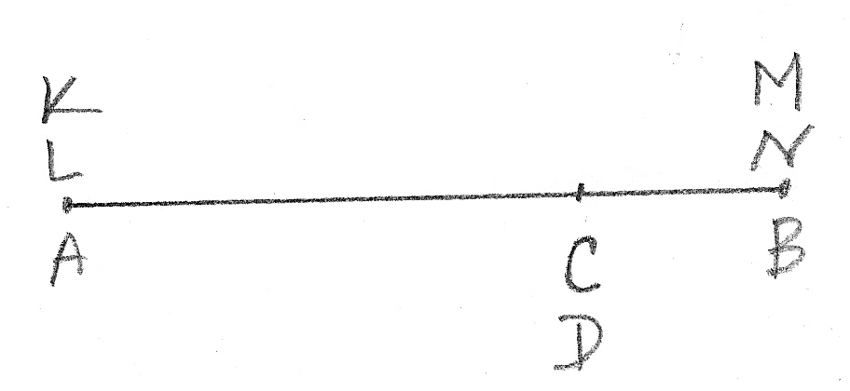
Proof #2
In this case, P(KLMN) = 4∆ and P(ABCD) = 3∆.

Slide 42
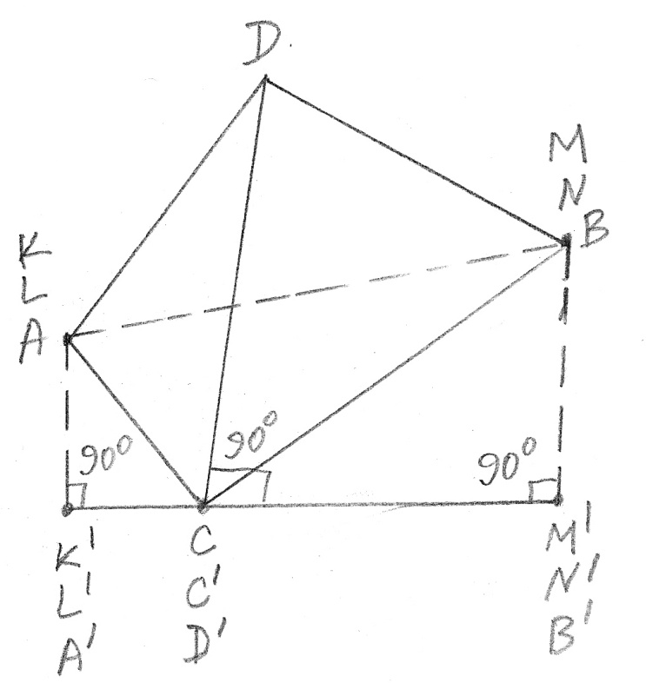
Proof #2
The projections of vertices C and D can be co-located only if edge CD of tetrahedron ABCD is perpendicular to the projection line.

Slide 43
Proof #2
So, the equality can only be true in certain projection lines, but not in ALL projection lines.
Hence, strict inequality
P(KLMN) < (4/3)*P(ABCD)
is proven for all pairs of nested tetrahedra KLMN and ABCD.

Slide 44
Proof #3
Lemma 1.
If point H belongs to the straight line segment KL, then, for any given three points E,F,G in the 3-D space, at least one of the following two inequalities is true:
P(EFGH) ≤ P(EFGK) or P(EFGH) ≤ P(EFGL).

Slide 45
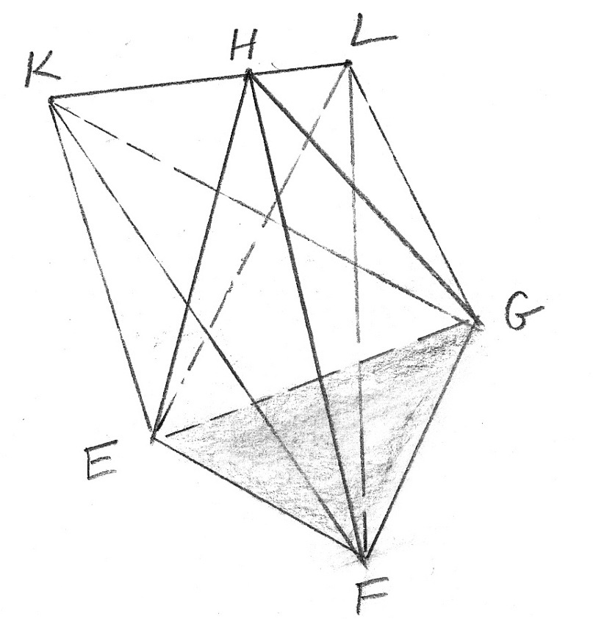
Proof #3
Lemma 1.
P(EFGH) ≤ P(EFGK) or P(EFGH) ≤ P(EFGL).

Slide 46
Proof #3
Note:
Equality
P(EFGH) = P(EFGK) and P(EFGH) = P(EFGL)
is possible only if K is the mid-point of KL segment and all three points, E, F, and G, are located on the same straight line with points H, K, L. Otherwise:
P(EFGH) < P(EFGK) or P(EFGH) < P(EFGL).

Slide 47
Proof #3
Based on Lemma 1, we can conclude: if vertex N of inner tetrahedron KLMN is not located in one the vertices of the outer tetrahedron ABCD, then there is a point P in one of vertices A, B, C, or D of tetrahedron ABCD such that
P(KLMN) ≤ P(KLMP).

Slide 48
Proof #3
Hence, we just need to prove that inequality
P(KLMN) ≤ (4/3)*P(ABCD)
is true for any tetrahedron KLMN whose all four vertices are vertices of ABCD.
From that, it will follow that this inequality is true for any tetrahedron KLMN inside ABCD.

Slide 49
Proof #3
Lemma 2.
For any edge, e.g. AB, of tetrahedron ABCD whose 4 vertices do not belong to one plane, the following inequality is true:
AB < (1/3)*P(ABCD).

Slide 50
Proof #3

Slide 51
Proof #3
c < d + f
c < a + b
c = c
3c < d + f + a + b + c < d + f + a +b + c + e
3*AB < P(ABCD)
AB < (1/3)*P(ABCD)

Slide 52
Proof #3
Configurations of tetrahedron KLMN whose all 4 vertices are vertices of ABCD:
a) 4 different vertices of tetrahedron KLMN are located in A, B, C, D:
P(KLMN) = P(ABCD) < (4/3)*P(ABCD).
b) All 4 vertices of tetrahedron KLMN are located in one vertex of ABCD, e.g., in A:
P(KLMN) = 0 < (4/3)*P(ABCD).

Slide 53
Proof #3
c) 1 vertex of tetrahedron KLMN is located in one vertex of ABCD, e.g., in A, and 3 vertices of KLMN are located in one vertex of ABCD, e.g., in B:
P(KLMN) = 3*AB < 4*AB.
Based on lemma 2:
P(KLMN) < 4*(1/3)*P(ABCD) = (4/3)*P(ABCD)
P(KLMN) < (4/3)*P(ABCD).

Slide 54
Proof #3
d) 2 vertices of tetrahedron KLMN are located in one vertex of ABCD, e.g., in A, and 2 other vertices of KLMN are located in another vertex of ABCD, e.g., in B:
P(KLMN) = 4*AB.
Based on lemma 2:
P(KLMN) < (4/3)*P(ABCD).

Slide 55
Proof #3
e) 2 vertices of tetrahedron KLMN are located in one vertex of ABCD, e.g., in A, 1 vertex of KLMN is located in another vertex of ABCD, e.g., B, and 1 vertex of KLMN is located in another vertex of ABCD, e.g., in C:

Slide 56
Proof #3

Slide 57
Proof #3
P(KLMN) = c + c + b + b + a
Since c < d + f and b < e + f
P(KLMN) < c + d + f + b + e + f + a =
= P(ABCD) + f
and, based on lemma 2,
P(KLMN) < P(ABCD) + (1/3)* P(ABCD)
P(KLMN) < (4/3)* P(ABCD).

Slide 58
Proof #3
Note: Coefficient 4/3 in this inequality cannot be reduced because there is one extreme configuration of KLMN inside ABCD in which equality P(KLMN) = (4/3)*P(ABCD) is reached, and there are configurations of KLMN inside ABCD whose P(KLMN) can come infinitely close to (4/3)* P(ABCD).

Slide 59
Proof #3

Slide 60
Proof #3
Let A and B be two ends of straight line segment AB. If one vertex of tetrahedron ABCD is in B and three other are in A, and also two vertices of inner tetrahedron KLMN are in A, and two other are in B, then:
P(KLMN) = 4*AB,
P(ABCD) = 3*AB,
so that, P(KLMN) = (4/3)* P(ABCD) .

Slide 61
Proof #3
If point A containing three vertices of ABCD is expanded into a very small triangle ACD, then the new tetrahedron ABCD has 4 vertices that do not belong to one plane.
Based on lemma 2:
AB < (1/3)*P(ABCD).
Since P(KLMN) = 4*AB is still true:
P(KLMN) < (4/3)* P(ABCD) is true.

Slide 62
Proof #3
By making triangle ACD smaller and smaller, we can make the value of P(KLMN) infinitely close to (4/3)* P(ABCD). This proves that coefficient 4/3 cannot be reduced in inequality P(KLMN) < (4/3)* P(ABCD).

